Slide 1
FLUORESCENCE SPECTROSCOPY
-An Introductory lecture

Slide 2




Colors of nature

Slide 3
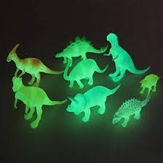
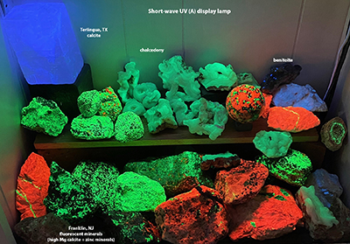
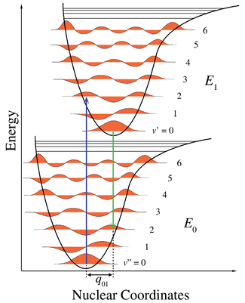
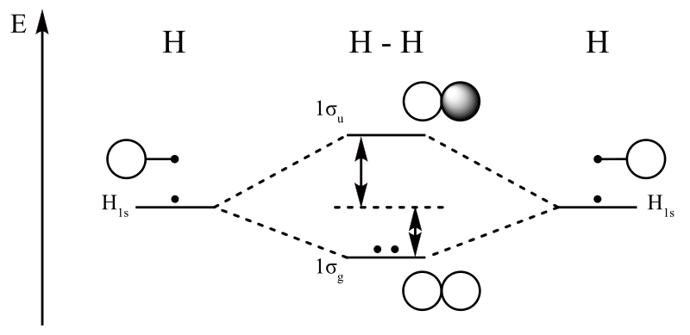
Principle of Fluorescence spectroscopy
Energy level diagrams
Molecular Orbital diagram
Frank-Condon diagram

Slide 4
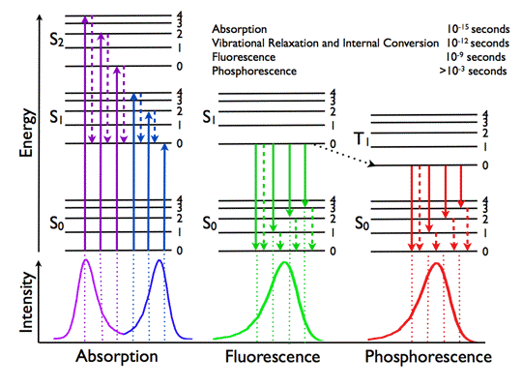
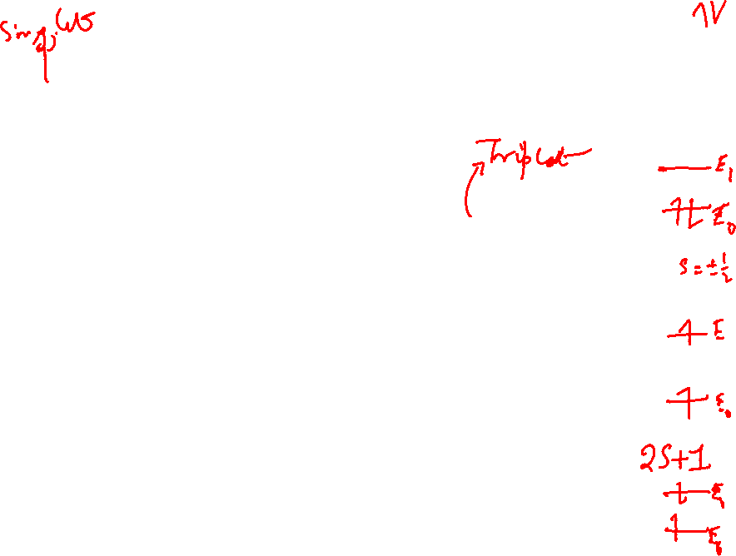
Photophysics – Jablonski Diagram

Slide 5
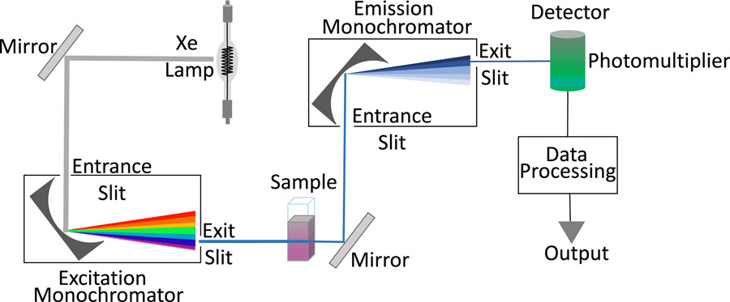
Measurement: Fluorescence spectrophotometer

Slide 6
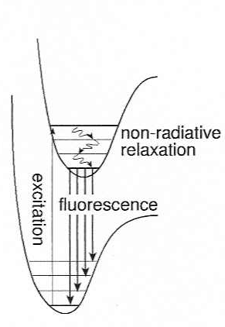
Kasha’s rule, Stokes shift and Mirror Image Rule
Kasha’s Rule: Invariance of emission wavelength with excitation wavelength
S₁
Stokes Shift: The fluorescent wavelength is red-shifted.
Magnitude of Stokes shift is effected by
Internal conversion
Solvent effects
Excited state kinetics
S_{o}

Slide 7
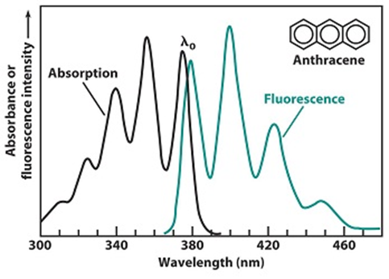
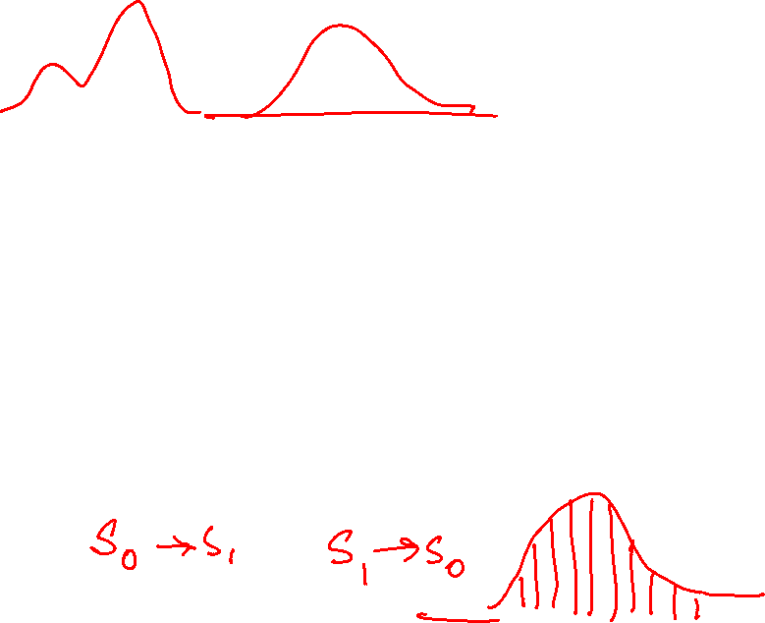
Mirror Image Rule: The fluorescence emission spectrum is mirror image of the absorption spectrum
v’=5
v’=4
v’=3
v’=2
v’=1
S₁
v’=0
v=5
v=4
v=3
v=2
v=1
S₀
v=0

Slide 8
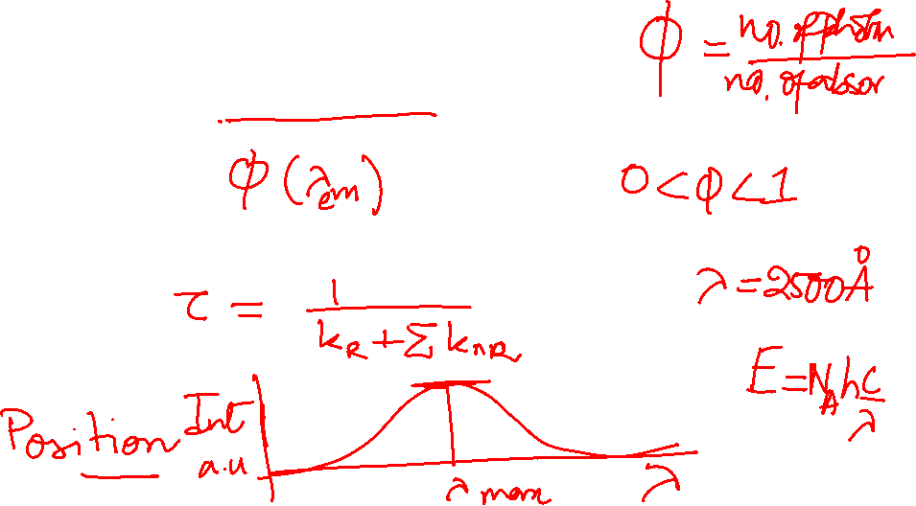
The important Fluorescence parameters
Fluorescence Intensity: Function of excitation wavelength and emission wavelength.
Fluorescence Quantum Yield: Intrinsic property – ratio of photons emitted in the radiative way upon photons absorbed
Fluorescence life time: The fluorescence emission spectrum is mirror image of the absorption spectrum
Position of the emission maxima: depends on environment

Slide 10
Fluorescence quenching
Fluorescence resonance energy transfer (FRET)

Slide 11
Fluorescence Resonance Energy Transfer
Electrodynamic phenomenon – “Spectroscopic ruler”
Occurs between donor (D) molecule in excited state and an acceptor
(A) molecule in the ground state
Energy transfer occur without photon emission
Long range dipole-dipole interaction
Energy transfer efficiency - donor-to-acceptor diffusion, distance
Rate of energy transfer depends
upon the extent of overlap
Quantum yield of donor
Relative orientation of donor-acceptor transition moment dipole
Distance between donor and acceptor

Slide 12
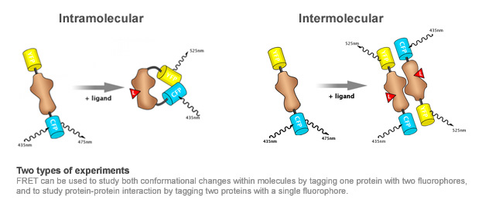

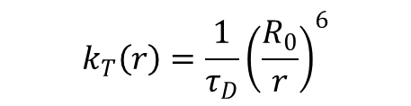
Rate of Resonance Energy Transfer
$$k_{T}\left(r\right)=\frac{1}{τ_{D}}{\left(\frac{R_{0}}{r}\right)}^{6}$$
$$R_{0}$$
: Forster distance – often 2 to 8 nm

Slide 13
Application
Quantification of protein denaturation
Quantify protein association with other macromolecules
Measures dynamics of proteins
Estimate internal viscosities of membrane
Investigate influence on membrane fluidity

